Slide 1
CST OOP MODLE 4
Advanced Features of Java –Collection framework

Slide 2
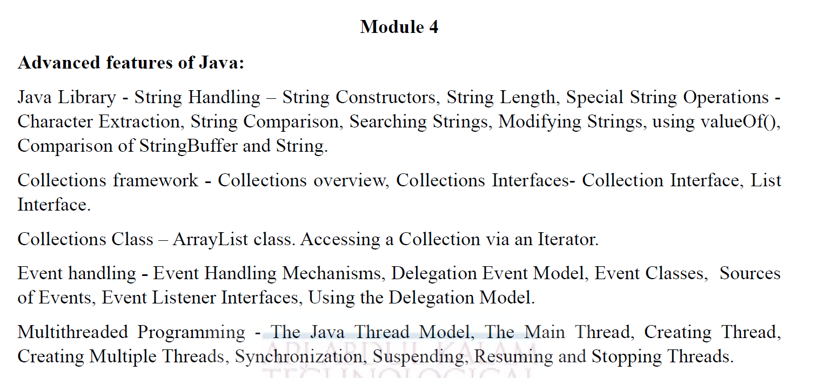
SYLLABUS

Slide 3
COURSE OUTCOME
CO2 | Develop Java application programs using java constructs, operators, control statements, built in packages, input /output streams, files and libraries and advanced features of java

Slide 4
OBJECTIVE
Collections framework
Collection Interfaces
List Interface
Arraylist class

Slide 5
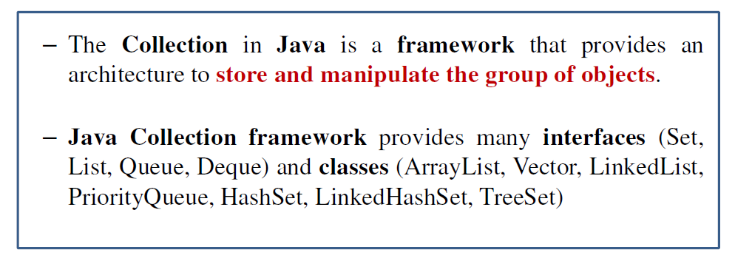
Collections framework Overview
The java.util package contains one of Java’s most powerful subsystems: The Collections Framework.
The Collections Framework is a sophisticated hierarchy of interfaces and classes that provide state-of-the-art technology(best possible technlogy) for managing groups of objects.

Slide 6
Collections framework Overview
Prior to Java 2, Java provided adhoc classes such as Dictionary, Vector, Stack, and Properties to store and manipulate groups of objects. Although these classes were quite useful, they lacked a central, unifying theme. Thus, the way that you used Vector was different from the way that you used Properties.
The collections framework was designed to meet several goals, such as −
The framework had to be high-performance. The implementations for the fundamental collections (dynamic arrays, linked lists, trees, and hashtables) were to be highly efficient.
The framework had to allow different types of collections to work in a similar manner and with a high degree of interoperability.
The framework had to extend and/or adapt a collection easily.

Slide 7
Collections framework Overview
A collections framework is a unified architecture for representing and manipulating collections. All collections frameworks contain the following −
Interfaces − These are abstract data types that represent collections. Interfaces allow collections to be manipulated independently of the details of their representation. In object-oriented languages, interfaces generally form a hierarchy.
Implementations, i.e., Classes − These are the concrete implementations of the collection interfaces. In essence, they are reusable data structures.
Algorithms − These are the methods that perform useful computations, such as searching and sorting, on objects that implement collection interfaces. The algorithms are said to be polymorphic: that is, the same method can be used on many different implementations of the appropriate collection interface.

Slide 8
Collections framework Overview
Another item closely associated with the Collections Framework is the Iterator interface.
– An iterator offers a general-purpose, standardized way of accessing the elements within a collection, one at a time.
– An iterator provides a means of enumerating the contents of a collection.
– Because each collection implements Iterator, the elements of any collection class can be accessed through the methods defined by Iterator

Slide 9
Advantages Collections framework
A collection is an object that represents a group of objects .A collections framework is a unified architecture for representing and manipulating collections, enabling collections to be manipulated independently of implementation details.The primary advantages of a collections framework are that it:
Reduces programming effort by providing data structures and algorithms so you don't have to write them yourself.
Increases performance by providing high-performance implementations of data structures and algorithms. Because the various implementations of each interface are interchangeable, programs can be tuned by switching implementations.
Provides interoperability between unrelated APIs by establishing a common language to pass collections back and forth.
Reduces the effort required to learn APIs by requiring you to learn multiple ad hoc collection APIs.
Reduces the effort required to design and implement APIs by not requiring you to produce ad hoc collections APIs.
Fosters software reuse by providing a standard interface for collections and algorithms with which to manipulate them.

Slide 10
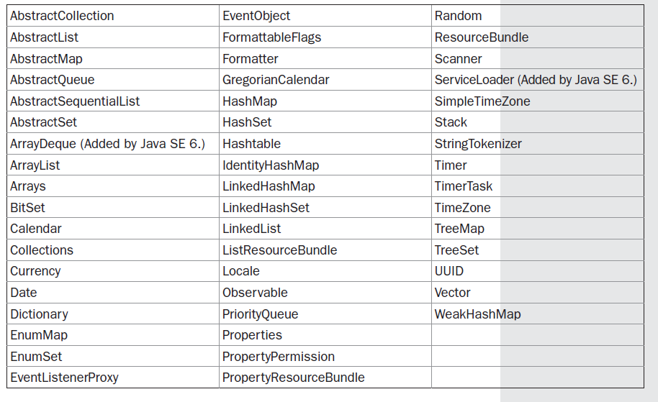
The Collections Framework
The Collections Framework is a sophisticated hierarchy of interfaces and classes that provide state-of-the-art technology for managing groups of objects.[java.util PACKAGE]
Classes in java.util

Slide 11
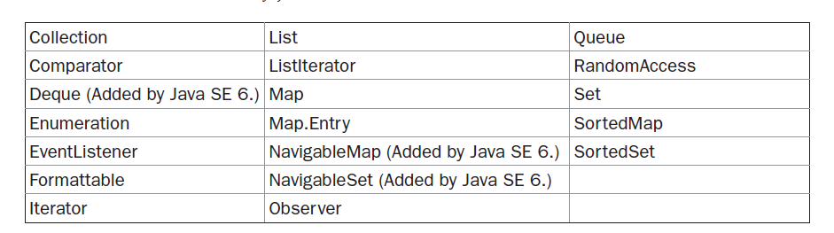
The Collections Framework
The interfaces defined by java.util are shown next:

Slide 12
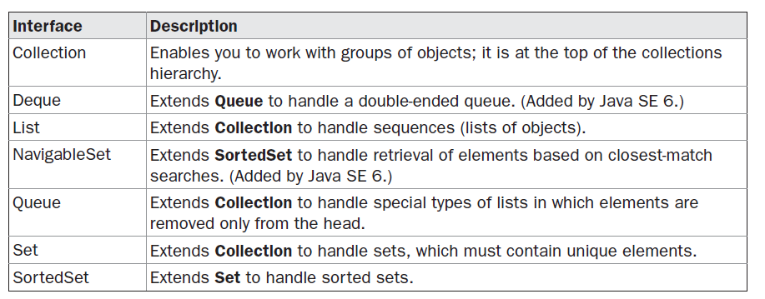
The Collection Interfaces
The interfaces defined by java.util are shown next:

Slide 13
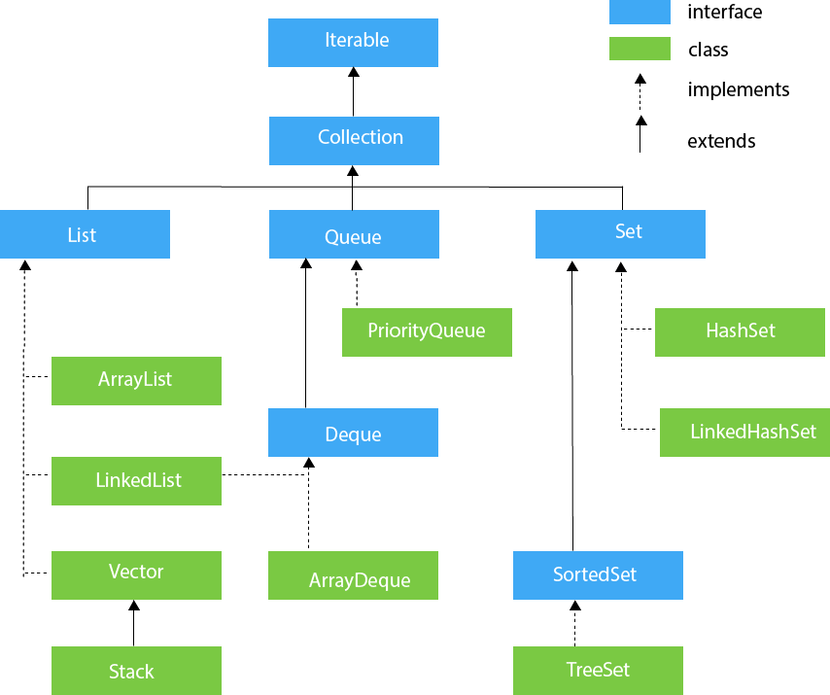
Hierarchy of Collection Framework

Slide 14
The Collection Interfaces
Recent Changes to Collections
Generics Fundamentally Change the Collections Framework
Autoboxing Facilitates the Use of Primitive Types
The For-Each Style for Loop

Slide 15
Generics in Java
The Java Generics programming is introduced in J2SE 5 to deal with type-safe objects. It makes the code stable by detecting the bugs at compile time.
Before generics, we can store any type of objects in the collection, i.e., non-generic. Now generics force the java programmer to store a specific type of objects.
Advantage of Java Generics
Type-safety: We can hold only a single type of objects in generics. It doesnt allow to store other objects.
Type casting is not required: There is no need to typecast the object.
Compile-Time Checking: It is checked at compile time so problem will not occur at runtime. The good programming strategy says it is far better to handle the problem at compile time than runtime.

Slide 16
Generics in Java
List list = new ArrayList();
list.add(10);
list.add("10");
With Generics, it is required to specify the type of object we need to store.
List<Integer> list = new ArrayList<Integer>();
list.add(10);
list.add("10");// compile-time error

Slide 17
Generics in Java
List list = new ArrayList();
list.add("hello");
String s = (String) list.get(0);//typecasting
After Generics, we don't need to typecast the object.
List<String> list = new ArrayList<String>();
list.add("hello");
String s = list.get(0);

Slide 18
The Collection Interface
The Collection Interface
java.util.Collection is the root interface in the collections hierarchy.
The Collection interface is the interface which is implemented by all the classes in the collection framework.
It declares the methods that every collection will have. In other words, we can say that the Collection interface builds the foundation on which the collection framework depends.
Collection is a generic interface that has this declaration:
interface Collection<E>
E specifies the type of objects that the collection will hold.
Collection extends the Iterable interface. This means that all collections can be cycled through by use of the for-each style for loop.
Collection declares the core methods that all collections will have.

Slide 19
The Collection Interface
Several of these methods can throw an UnsupportedOperationException
A ClassCastException is generated when one object is incompatible with another, such as when an attempt is made to add an incompatible object to a collection.
A NullPointerException is thrown if an attempt is made to store a null object and null elements are not allowed in the collection.
An IllegalArgumentException is thrown if an invalid argument is used.
An IllegalStateException is thrown if an attempt is made to add an element to a fixed-length collection that is full.
.

Slide 20
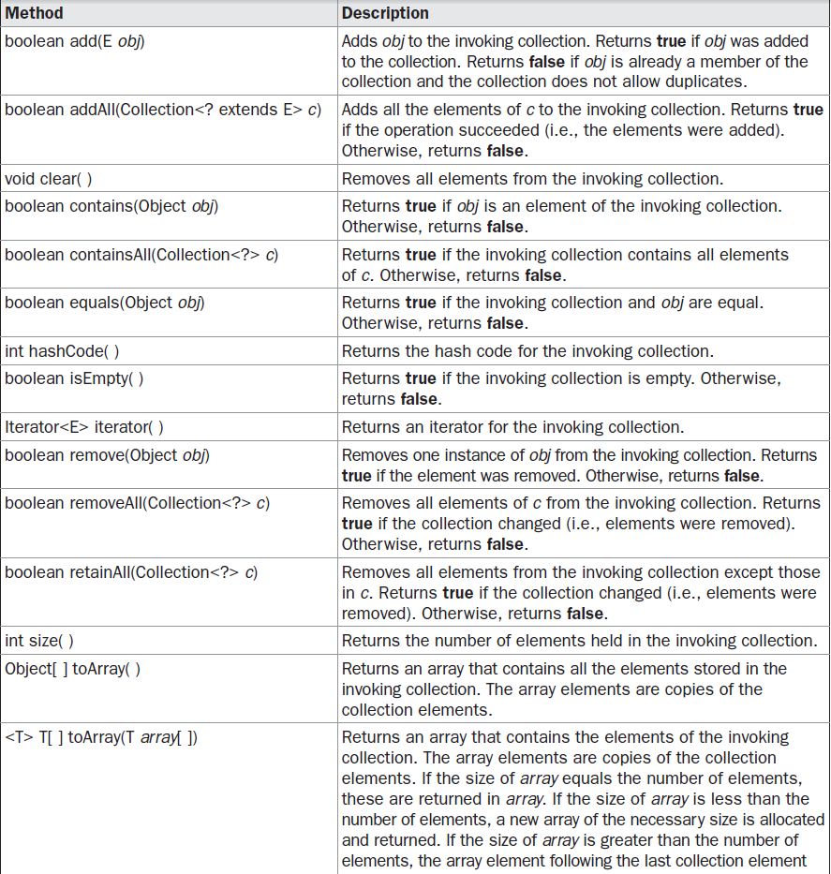
The Collection Interface

Slide 21
The Collection Interfaces
Objects are added to a collection by calling add( ).
add( ) takes an argument of type E, which means that objects added to a collection must be compatible with the type of data expected by the collection.
You can add the entire contents of one collection to another by calling addAll( ).
You can remove an object by using remove( ).
To remove a group of objects, call removeAll( ).
You can remove all elements except those of a specified group by calling retainAll( ).
To empty a collection, call clear( ).
You can determine whether a collection contains a specific object by calling contains( ).
To determine whether one collection contains all the members of another, call containsAll( ).
You can determine when a collection is empty by calling isEmpty( ). The number of elements
currently held in a collection can be determined by calling size( ).

Slide 22
The Collection Interfaces
The toArray( ) methods return an array that contains the elements stored in the invoking
collection.
The first returns an array of Object. The second returns an array of elements that have the same type as the array specified as a parameter.
Normally, the second form is more convenient because it returns the desired array type.
Two collections can be compared for equality by calling equals( ).
The precise meaning of“equality” may differ from collection to collection.
For example, you can implement equals( ) so that it compares the values of elements stored in the collection.
Alternatively, equals( ) can compare references to those elements.
One more very important method is iterator( ), which returns an iterator to a collection.
Iterators are frequently used when working with collections.

Slide 23
The List Interface
The List interface extends Collection and declares the behavior of a collection that stores a sequence of elements.
Elements can be inserted or accessed by their position in the list, using a zero-based index. A list may contain duplicate elements.
List is a generic interface that has this declaration:
interface List<E> -Here, E specifies the type of objects that the list will hold.
To the versions of add( ) and addAll( ) defined by Collection, List adds the methods add(int, E) and addAll(int, Collection).
These methods insert elements at the specified index.
Also, the semantics of add(E) and addAll(Collection) defined by Collection are changed by List so that they add elements to the end of the list.
To obtain the object stored at a specific location, call get( ) with the index of the object.
To assign a value to an element in the list, call set( ), specifying the index of the object to be changed.
To find the index of an object, use indexOf( ) or lastIndexOf( ).
You can obtain a sublist of a list by calling subList( ), specifying the beginning and ending indexes of the sublist. As you can imagine, subList( ) makes list processing quite convenient.

Slide 24
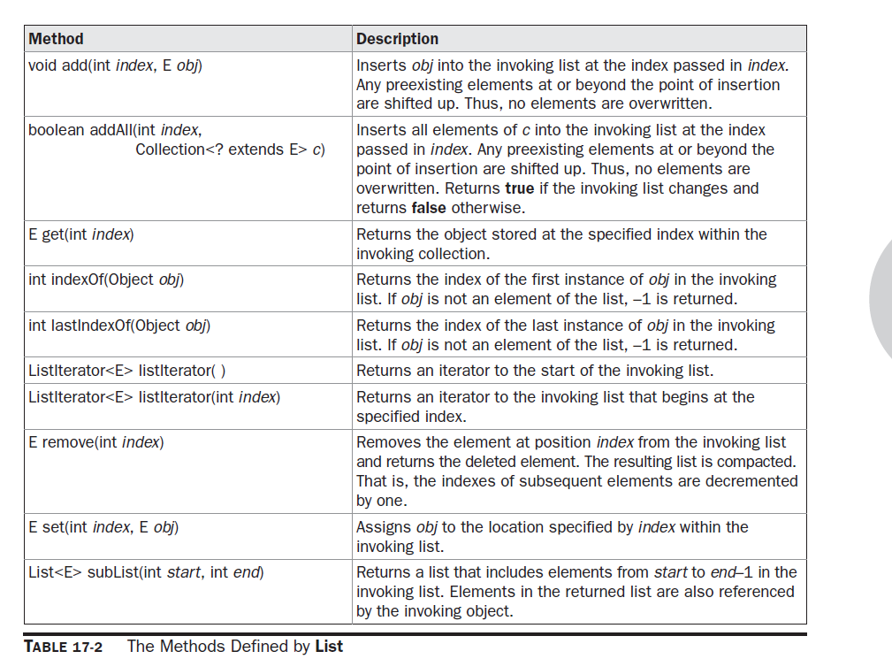
The List Interface

Slide 25
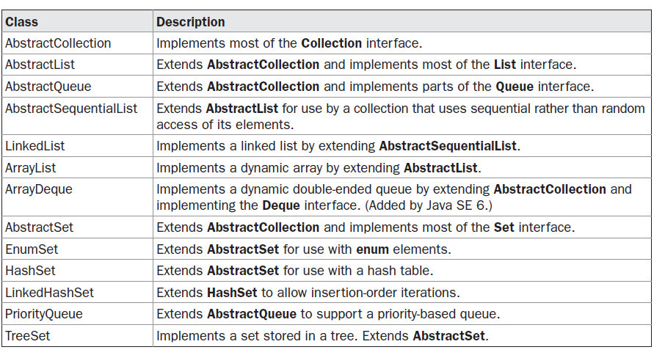
The Collection Classes

Slide 26
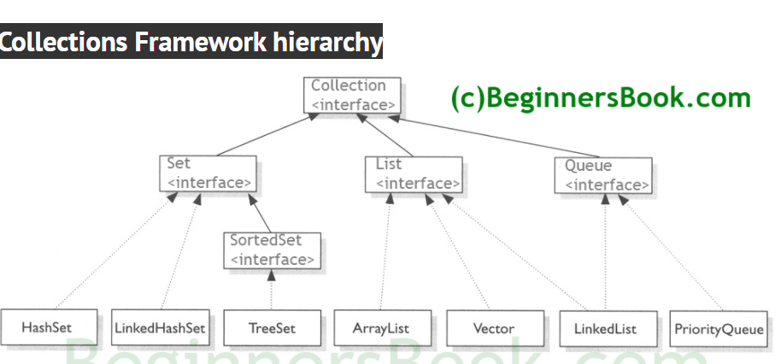
The Collection Classes

Slide 27
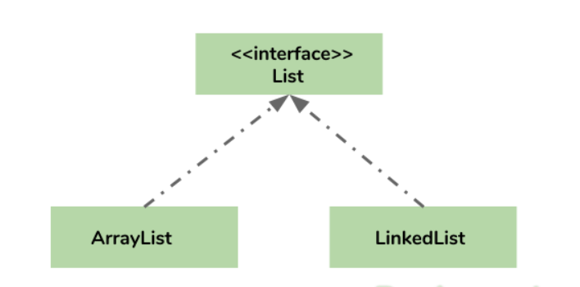
The ArrayList Class
Arraylist class implements List interface and it is based on an Array data structure.
It is widely used because of the functionality and flexibility it offers.
Most of the developers choose Arraylist over Array as it’s a very good alternative of traditional java arrays.
ArrayList is a resizable-array implementation of the List interface.
It implements all optional list operations, and permits all elements, including null.

Slide 28
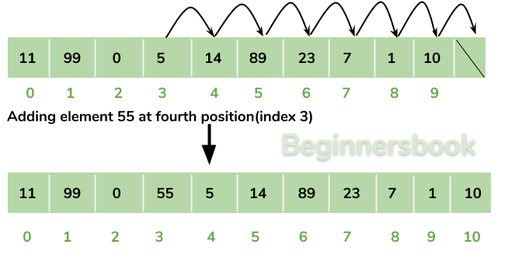
Why ArrayList is better than Array?
The limitation with array is that it has a fixed length so if it is full you cannot add any more elements to it, likewise if there are number of elements gets removed from it the memory consumption would be the same as it doesn’t shrink.
On the other ArrayList can dynamically grow and shrink after addition and removal of elements (See the images below). Apart from these benefits ArrayList class enables us to use predefined methods of it which makes our task easy.

Slide 29
The ArrayList Class
ArrayList has the constructors shown here:
ArrayList( )
ArrayList(Collection<? extends E> c)
ArrayList(int capacity)
The first constructor builds an empty array list.
The second constructor builds an array list that is initialized with the elements of the collection c.
The third constructor builds an array list that has the specified initial capacity.
The capacity is the size of the underlying array that is used to store the elements.
The capacity grows automatically as elements are added to an array list.

Slide 30
The ArrayList Class
ArrayList<String> alist=new ArrayList<String>();
alist.add("Steve"); //This will add "Steve" at the end of List
alist.add(3, "Steve"); //This will add "Steve" at the fourth position

Slide 31
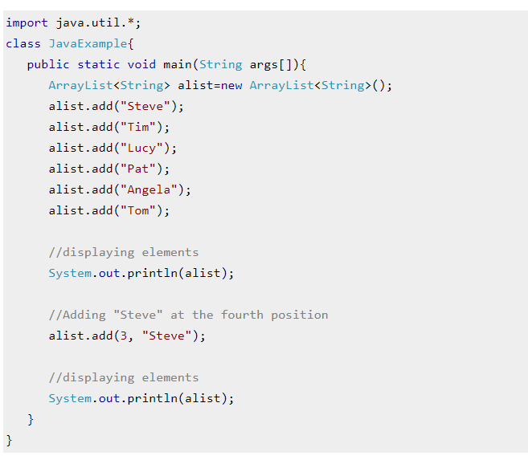
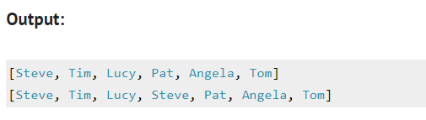
The ArrayList Class

Slide 32
The ArrayList Class
// Demonstrate ArrayList. import java.util.*; class ArrayListDemo { public static void main(String args[]) { // Create an array list. ArrayList<String> al = new ArrayList<String>(); System.out.println("Initial size of al: " + al.size()); // Add elements to the array list. al.add("C"); al.add("A"); al.add("E"); al.add("B"); al.add("D"); al.add("F"); al.add(1, "A2"); | System.out.println("Size of al after additions: " + al.size()); // Display the array list. System.out.println("Contents of al: " + al); // Remove elements from the array list. al.remove("F"); al.remove(2); System.out.println("Size of al after deletions: " + al.size()); System.out.println("Contents of al: " + al); } } The output from this program is shown here: Initial size of al: 0 Size of al after additions: 7 Contents of al: [C, A2, A, E, B, D, F] Size of al after deletions: 5 Contents of al: [C, A2, E, B, D]

Slide 33
The ArrayList Class
Although the capacity of an ArrayList object increases automatically as objects are stored in it, you can increase the capacity of an ArrayList object manually by calling ensureCapacity( ).
The signature for ensureCapacity( ) is shown here:
void ensureCapacity(int cap) --Here, cap is the new capacity.
Conversely, if you want to reduce the size of the array that underlies an ArrayList object so that it is precisely as large as the number of items that it is currently holding, call trimToSize( ),
void trimToSize( )

Slide 34
The ArrayList Class
Obtaining an Array from an ArrayList
When working with ArrayList, you will sometimes want to obtain an actual array that contains the contents of the list. You can do this by calling toArray( ), which is defined by Collection.
Several reasons exist why you might want to convert a collection into an array, such as:
• To obtain faster processing times for certain operations
• To pass an array to a method that is not overloaded to accept a collection
• To integrate collection-based code with legacy code that does not understand collections
Object[ ] toArray( )
<T> T[ ] toArray(T array[ ])
The first returns an array of Object. The second returns an array of elements that have the same type as T.
Normally, the second form is more convenient because it returns the proper type of array.

Slide 35
The ArrayList Class
// Convert an ArrayList into an array. import java.util.*; class ArrayListToArray { public static void main(String args[]) { // Create an array list. ArrayList<Integer> al = new ArrayList<Integer>(); // Add elements to the array list. al.add(1); al.add(2); al.add(3); al.add(4); System.out.println("Contents of al: " + al); | // Get the array. Integer ia[] = new Integer[al.size()]; ia = al.toArray(ia); int sum = 0; // Sum the array. for(int i : ia) sum += i; System.out.println("Sum is: " + sum); } } The output from the program is shown here: Contents of al: [1, 2, 3, 4] Sum is: 10

Slide 36
Accessing a Collection via an Iterator
Often, you will want to cycle through the elements in a collection.
One way to do this is to employ an iterator, which is an object that implements either the Iterator or the ListIterator interface.
Iterator enables you to cycle through a collection, obtaining or removing elements.
ListIterator extends Iterator to allow bidirectional traversal of a list, and the modification of elements. Iterator and ListIterator are generic interfaces which are declared as shown here:
interface Iterator<E>
interface ListIterator<E>
Here, E specifies the type of objects being iterated.

Slide 37
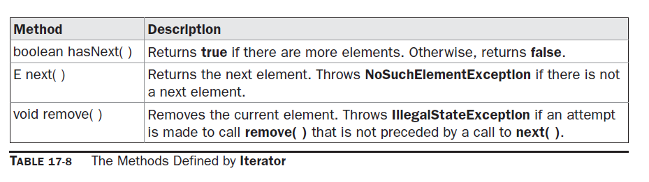
Accessing a Collection via an Iterator

Slide 38
Accessing a Collection via an Iterator
Using an Iterator
Before you can access a collection through an iterator, you must obtain one.
Each of the collection classes provides an iterator( ) method that returns an iterator to the start of the collection.
By using this iterator object, you can access each element in the collection, one element at a time.
In general, to use an iterator to cycle through the contents of a collection, follow these steps:
1. Obtain an iterator to the start of the collection by calling the collection’s iterator( )
method.
2. Set up a loop that makes a call to hasNext( ). Have the loop iterate as long as hasNext( )
returns true.
3. Within the loop, obtain each element by calling next( ).

Slide 39
Accessing a Collection via an listIterator
For collections that implement List, you can also obtain an iterator by calling listIterator( ).
As explained, a list iterator gives you the ability to access the collection in either the forward or backward direction and lets you modify an element.
Otherwise, ListIterator is used just like Iterator.
The following example implements these steps, demonstrating both the Iterator and ListIterator interfaces.
It uses an ArrayList object, but the general principles apply to any type of collection.
Of course, ListIterator is available only to those collections that implement the List interface.

Slide 40
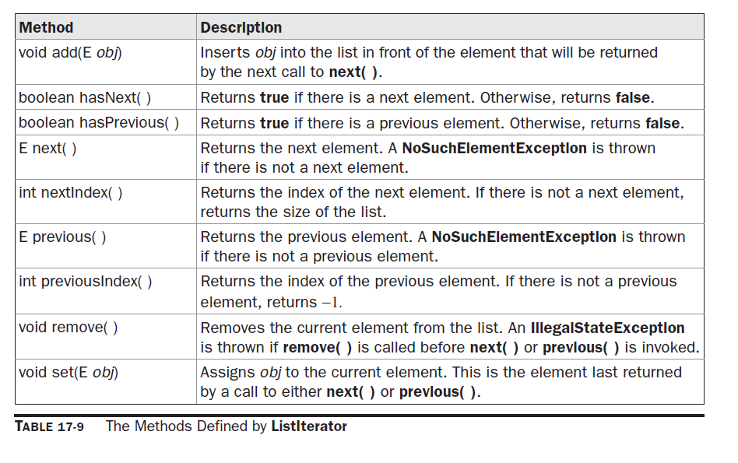
Accessing a Collection via ListIterator

Slide 41
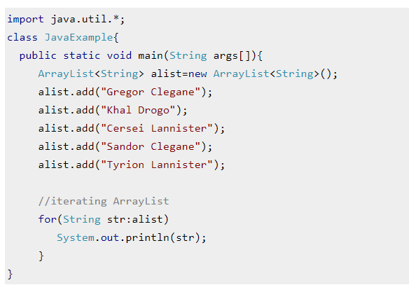
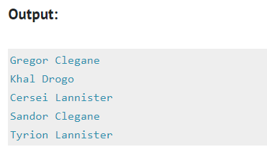
Iterating ArrayList using for each

Slide 42
Accessing a Collection via an Iterator and listIterator
// Demonstrate iterators. import java.util.*; class IteratorDemo { public static void main(String args[]) { // Create an array list. ArrayList<String> al = new ArrayList<String>(); // Add elements to the array list. al.add("C"); al.add("A"); al.add("E"); al.add("B"); al.add("D"); al.add("F"); // Use iterator to display contents of al. System.out.print("Original contents of al: "); Iterator<String> itr = al.iterator(); while(itr.hasNext()) { String element = itr.next(); System.out.print(element + " "); } | System.out.println(); // Modify objects being iterated. ListIterator<String> litr = al.listIterator(); while(litr.hasNext()) { String element = litr.next(); litr.set(element + "+"); } System.out.print("Modified contents of al: "); itr = al.iterator(); while(itr.hasNext()) { String element = itr.next(); System.out.print(element + " "); }

Slide 43
Accessing a Collection via an Iterator and listIterator
System.out.println(); // Now, display the list backwards. System.out.print("Modified list backwards: "); while(litr.hasPrevious()) { String element = litr.previous(); System.out.print(element + " "); } System.out.println(); }} The output is shown here: Original contents of al: C A E B D F Modified contents of al: C+ A+ E+ B+ D+ F+ Modified list backwards: F+ D+ B+ E+ A+ C+

Slide 44
Accessing a Collection via for-each for loop
// Use the for-each for loop to cycle through a collection. import java.util.*; class ForEachDemo { public static void main(String args[]) { // Create an array list for integers. ArrayList<Integer> vals = new ArrayList<Integer>(); // Add values to the array list. vals.add(1); vals.add(2); vals.add(3); vals.add(4); vals.add(5); // Use for loop to display the values. System.out.print("Original contents of vals: "); for(int v : vals) System.out.print(v + " "); | System.out.println(); // Now, sum the values by using a for loop. int sum = 0; for(int v : vals) sum += v; System.out.println("Sum of values: " + sum); } } The output from the program is shown here: Original contents of vals: 1 2 3 4 5 Sum of values: 15

Slide 45
Iterator vs ListIterator
1) Iterator is used for traversing List and Set both.
We can use ListIterator to traverse List only, we cannot traverse Set using ListIterator.
2) We can traverse in only forward direction using Iterator.
Using ListIterator, we can traverse a List in both the directions (forward and Backward).
3) We cannot obtain indexes while using Iterator
We can obtain indexes at any point of time while traversing a list using ListIterator. The methods nextIndex() and previousIndex() are used for this purpose.
4) We cannot add element to collection while traversing it using Iterator, it throws ConcurrentModificationException when you try to do it.
We can add element at any point of time while traversing a list using ListIterator.
5) We cannot replace the existing element value when using Iterator.
By using set(E e) method of ListIterator we can replace the last element returned by next() or previous() methods.

Slide 46
Iterator vs ListIterator
Methods of Iterator:
hasNext()
next()
remove()
Methods of ListIterator:
add(E e)
hasNext()
hasPrevious()
next()
nextIndex()
previous()
previousIndex()
remove()
set(E e)
.

